Slide 1
CHAPTER 6 Predictive Control with tracking 8 examples of dual-mode approaches
Anthony Rossiter

Slide 2
Introduction
The previous video showed how advance knowledge of the target could be integrated into an OMPC set up.
It was shown that this has a direct and explicit impact on the perturbation term which deviates behaviour from an unconstrained optimal (with fixed target).
This video explores the impact in more detail and gives numerical demonstrations.

Slide 3
Dual-mode predictions with time varying target
Nominal predictions have the dynamics below which are optimal if the target is fixed (and no constraints):
The perturbation term c_{k} is used primarily for constraint handling.
However it is also available to optimise performance in cases where these predictions are not optimal, such as for time varying targets or a suboptimal terminal mode.

Slide 4
Unbiased cost and control
Using a typical unbiased cost function:
The previous video showed that the unconstrained values for the perturbations are given as:
This video will have S_{xc}=0.
Perturbations to make use of advance information on the target
Perturbations where terminal feedback is not optimal (see chap. 4).

Slide 5
Effect of advance knowledge
By definition (optimal control theory), if the set point is fixed, then the optimal state feedback is fixed.
This implies that if the target is fixed then the optimal perturbation term must be ZERO!
The obvious corollary is that for this case we expect:

Slide 6
Effect of advance knowledge
If the target is fixed then:
We expect:
This can checked in any MATLAB code.

Slide 7
video6_8_example1.m
This file creates the feed forward term and demonstrates that it has a zero steady-state gain, for all values of advance knowledge.
The feed forward term also has a clear structure which is expected with optimal control solutions.
The feed forward term itself is clearly non-zero and significant so will impact when the target is not constant.

Slide 8
video6_8_example2.m
This file creates the feed forward term and demonstrates that it has a zero steady-state gain, for all values of advance knowledge.
The feed forward term itself is clearly non-zero and significant so will impact when the target is not constant.

Slide 9
Impact of feed forward
The next few slides given examples that using advance information with OMPC does indeed improve behaviour, up to a point.
However, as with GPC, using too much advance information in conjunction with a low n_{c} can be counter productive.
Note this algorithm is penalising deviations from steady-state inputs and this will impact on responses somewhat.

Slide 10
video6_9_example1.m
Anticipates set point change.
Smaller overshoot and less aggressive initial control moves.
Disturbance rejection the same

Slide 11
Too much advance knowledge with low n_{c} is not helpful.

Slide 12
video6_9_example2.m
Anticipates set point change.
Clearly better tracking for target change in loop 2.

Slide 13
Summary
This video has shown code which implements advance information within an OMPC law.
It is clear that the information can be used systematically and does affect behaviour by changing the perturbation parameter c_{k}.
Up to a limit, using this information is helpful.
Choosing n_{a}>n_{c} is not to be advised in general.
It will be possible to use trial and error as in video 6_4 to determine a suitable n_{a}.
So far, this chapter has ignored constraints. The inclusion of constraints will also have a marked impact on how much future information is useful.

Slide 14



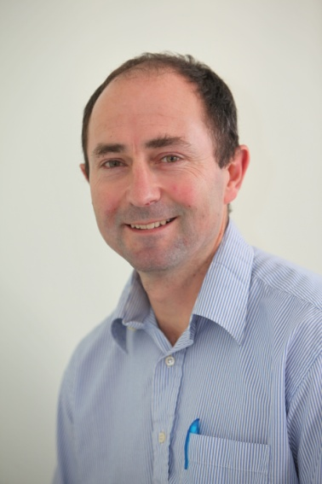
Anthony Rossiter
Department of Automatic Control and Systems Engineering
University of Sheffield
www.shef.ac.uk/acse
© 2014 University of Sheffield
This work is licensed under the Creative Commons Attribution 2.0 UK: England & Wales Licence. To view a copy of this licence, visit http://creativecommons.org/licenses/by/2.0/uk/ or send a letter to: Creative Commons, 171 Second Street, Suite 300, San Francisco, California 94105, USA.
It should be noted that some of the materials contained within this resource are subject to third party rights and any copyright notices must remain with these materials in the event of reuse or repurposing.
If there are third party images within the resource please do not remove or alter any of the copyright notices or website details shown below the image.
(Please list details of the third party rights contained within this work.
If you include your institutions logo on the cover please include reference to the fact that it is a trade mark and all copyright in that image is reserved.)

